Slide 1
Data-Driven Real-Time State Estimator Using Machine Learning for Transmission System
Tasks 5 and 6 Update
Evangelos Farantatos, Paul Myrda, Mahendra Patel
EPRI
Anamitra Pal, Assistant Professor
Arizona State University
Feb 23, 2022

Slide 2

Presentation Outline
Project Objectives
Project Timeline
Task 2 Summary
Task 3 Summary
Task 5: Output Post-processing
Handling bad data and missing data
Differentiating bad data and extreme data
Task 6: Software Development
GUI visualization
Summary and Upcoming Tasks

Slide 3
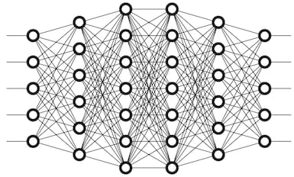
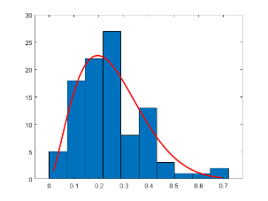
Data Driven Real Time State Estimator using Machine Learning for Transmission Systems
OBJECTIVES:
Develop a Bayesian state estimator with the following characteristics:
Capable of estimating states (complex voltages) in the presence of measurements from topologically unobserved systems
Independent of the measurement error distribution
Capable of estimating states at the rate of 30 samples per second utilizing time-synchronized measurements as real-time inputs
Develop approaches to counter bad data and test their robustness against different types of bad/missing data
Develop ways to update the Machine Learning (ML)-based state estimator in presence of topology changes and system events
Offline Learning
Online Implementation
Probability distribution fitting from input data
Real-time PMU measurements
State Estimates
Optimized DNN parameters
Monte Carlo sampling
Training sample generation
Deep neural network (DNN) training
Approximating conditional expectation
$\min_{\hat{x}(.)}{𝔼\left({\left\|x−\hat{x}\left(z\right)\right\|}^{2}\right)⇒{\hat{x}}^{∗}\left(z\right)=}$ $𝔼(x|z)$

Slide 4
Data Driven Real Time State Estimator using Machine Learning for Transmission Systems
Timeline
Task | Topic | Due Date | Oct.-Feb. | Mar.-Jul. | Aug.-Nov.
1 | Machine Learning Model Development for State Estimation | Feb. 28, 2021
2 | Machine Learning Based State Estimation with Limited Number of PMUs | Jul. 30, 2021
3 | Machine Learning Based State Estimation with Missing and Bad Data | Nov. 30, 2021
4 | Machine Learning Based State Estimation under Event Conditions and System Topology Changes | Nov. 30, 2021

Slide 5
Data Driven Real Time State Estimator using Machine Learning for Transmission Systems
Timeline Contd.
Task | Topic | Due Date | Dec.-Apr. | May-Sep. | Oct.-Dec.
5 | Machine Learning Based State Estimation Output Post-Processing | April 30, 2022
6 | Machine Learning Based State Estimation Software Development | Sep. 30, 2022
7 | Machine Learning Based State Estimation Case Studies | Dec. 31, 2022
-- | Final Report and Software Tool | Dec. 31, 2022

Slide 6
Summary of Tasks 2 and 3

Slide 7
Task 2 Summary: ML-based State Estimator
Optimal tuning of the hyperparameters of a deep neural network (DNN) was carried out using a random search framework
Even with smaller number of PMUs [13 instead of 32], the DNN state estimation (SE) model was able to reasonably estimate the states of the system
The state estimation results were good even in presence of non-Gaussian noise in the measurements

Slide 8
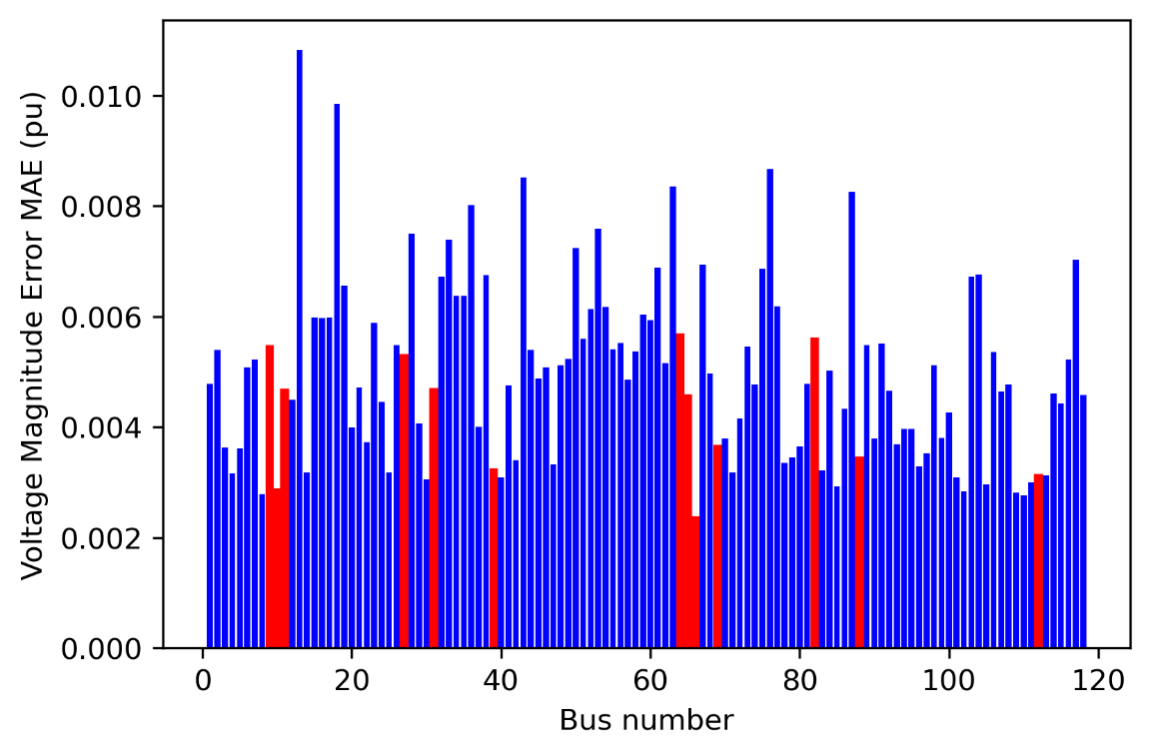
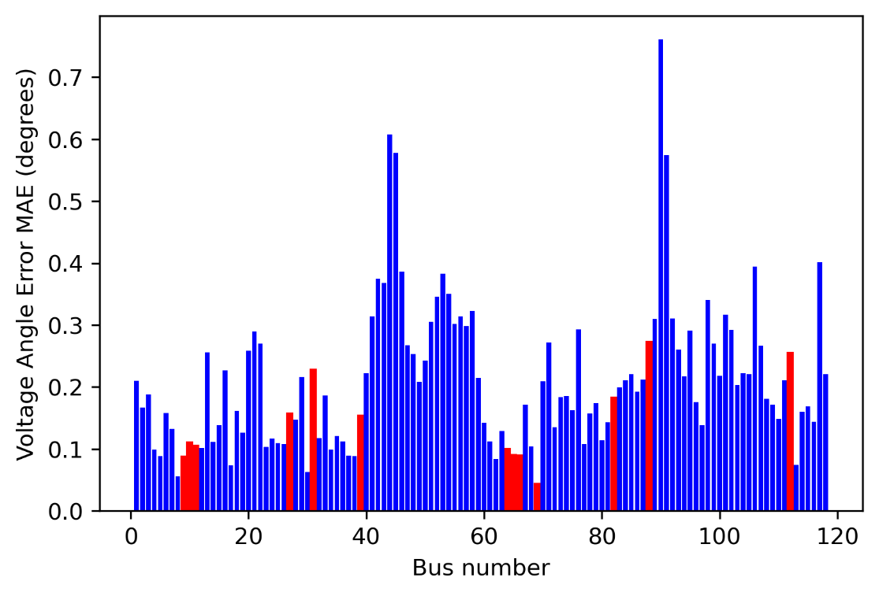
DNN-SE Results with 13 PMUs in presence of Laplacian noise
Red color: Bus locations where PMUs are placed
Blue color: Bus locations where PMUs are not placed

Slide 9
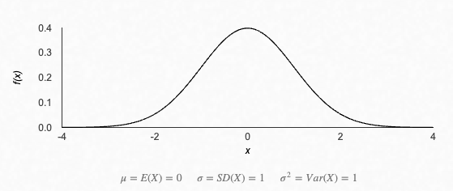
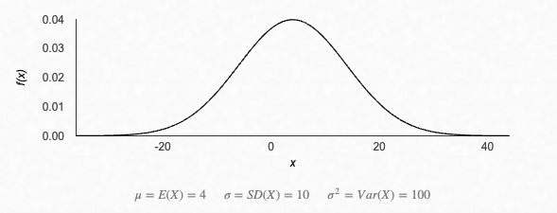
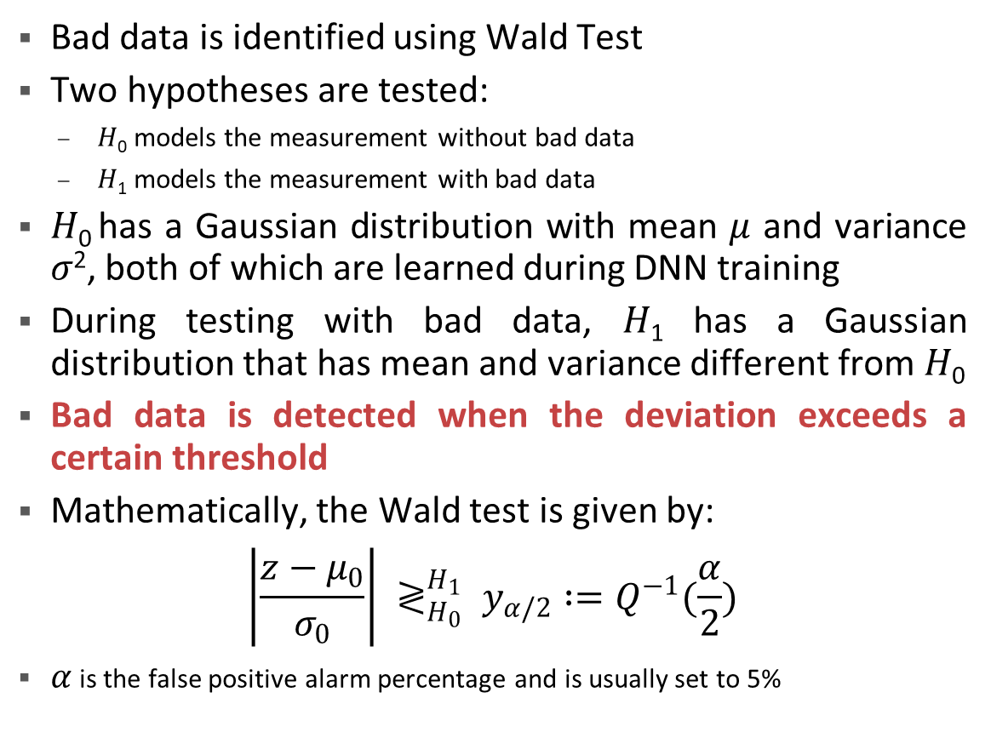
Task 3 Summary: Bad Data and Missing Data Detection
Normalized Input Data
Bad data is identified using Wald Test
Two hypotheses are tested:
𝐻₀ models the measurement without bad data
𝐻₁ models the measurement with bad data
𝐻₀ has a Gaussian distribution with mean 𝜇 and variance 𝜎², both of which are learned during DNN training
During testing with bad data, 𝐻₁ has a Gaussian distribution that has mean and variance different from 𝐻₀
Bad data is detected when the deviation exceeds a certain threshold
Mathematically, the Wald test is given by:
$$\left|\frac{z−μ_{0}}{σ_{0}}\right| ≷_{H_{0}}^{H_{1}} y_{α/2} :=Q^{−1}(\frac{α}{2})$$
$α$ is the false positive alarm percentage and is usually set to 5%
Bad Data

Slide 10
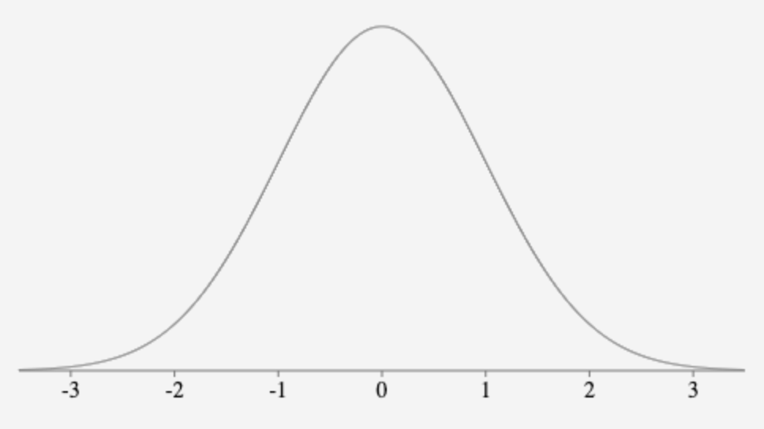
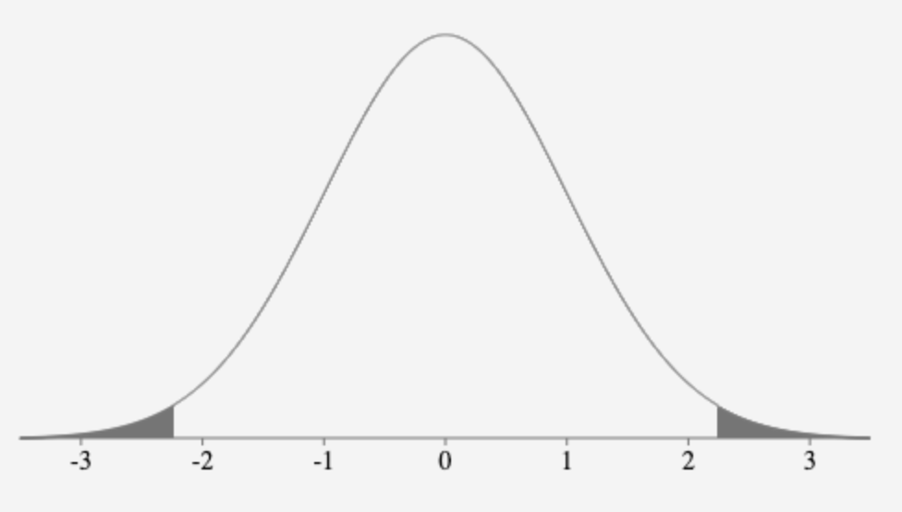
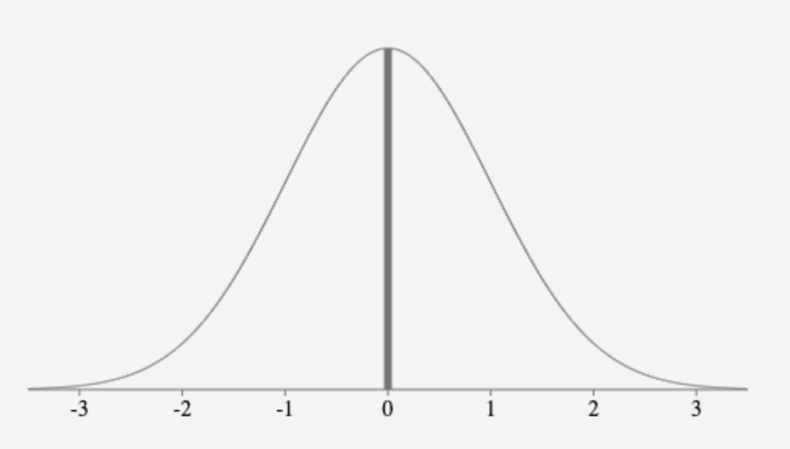
Bad Data and Missing Data Replacement by Mean value
Obtain 𝜇 and 𝜎² from normalized training data
Set the threshold for false positive
Normalized real-time data points larger than the threshold will be replaced by the expected value of the normal distribution

Slide 11
Task 5: Machine Learning Based State Estimation Output Post-Processing

Slide 12
Bad Data and Missing Data Replacement by Nearest Operating Condition (OC)
Obtain 𝜇 and 𝜎² from normalized training data
Set the threshold for false positive
Normalized real-time data points larger than the threshold will be replaced by the corresponding value from the closest OC in the L₂ sense

Slide 13
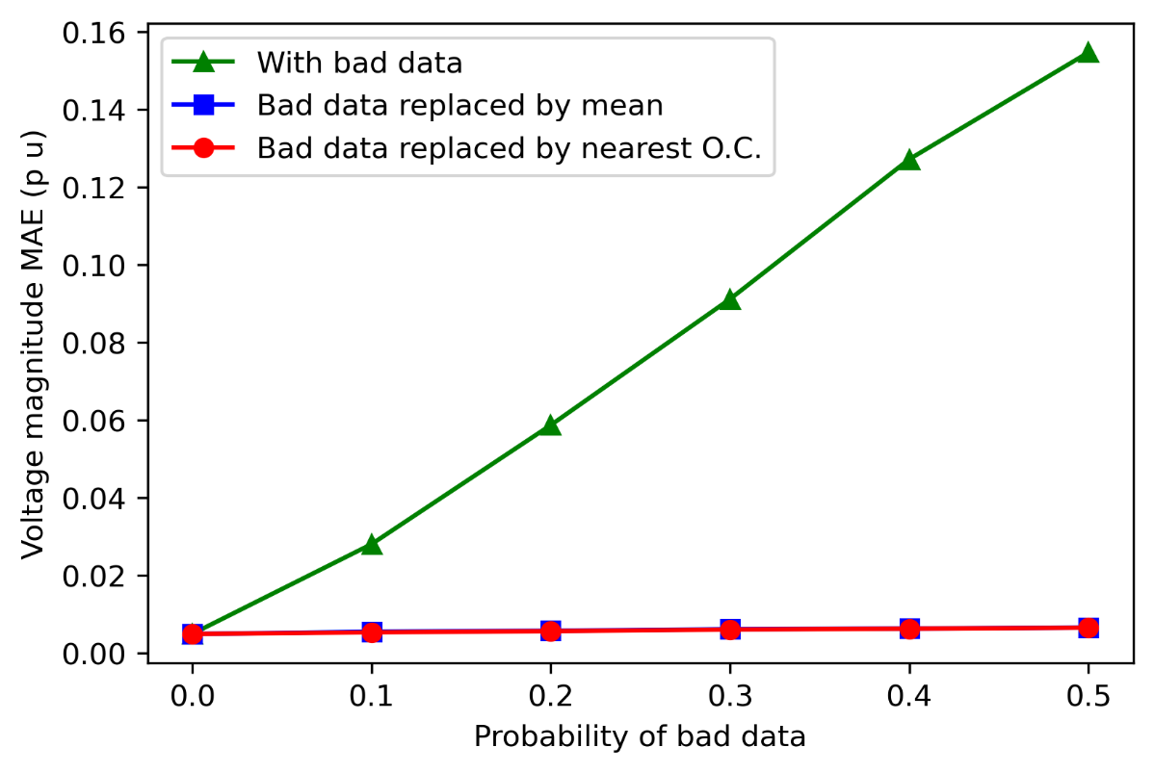
Bad Data Detection with and without Replacement
If bad data is not replaced, the voltage magnitude MAE increases from 0.0049 to 0.1546 when the probability of bad data is increased from 0 to 0.5
Replacing bad data using either of the two approaches resulted in much higher accuracy

Slide 14
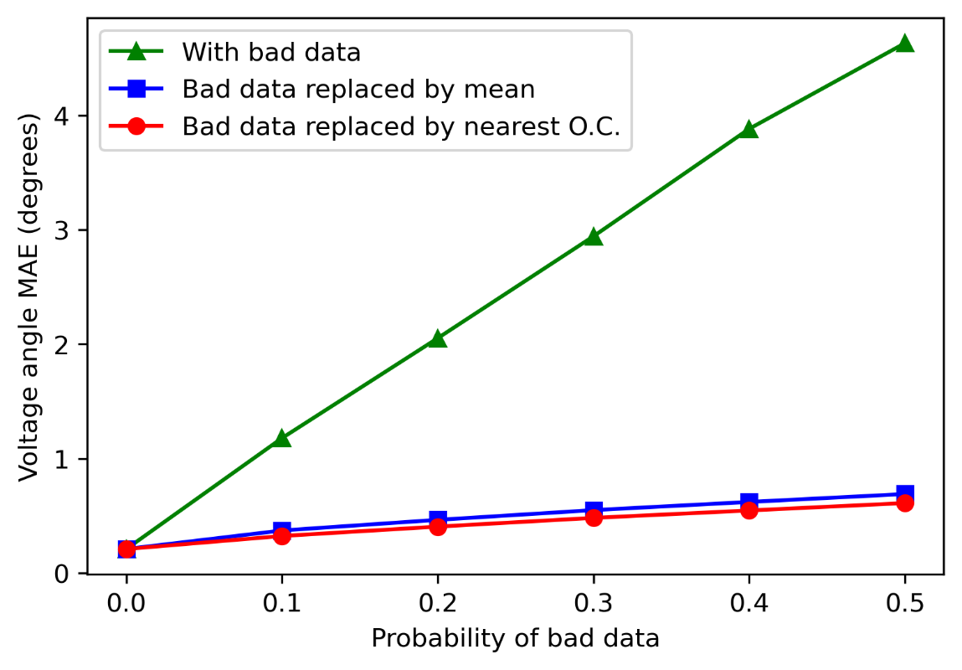
Bad Data Detection with and without Replacement
A similar effect was observed for voltage phase angle estimation
In presence of 50% bad data, the voltage angle MAE went up to 4.63°
For the same case, when the bad data was replaced using mean and nearest OC, the MAE decreased to 0.69° and 0.61°, respectively

Slide 15
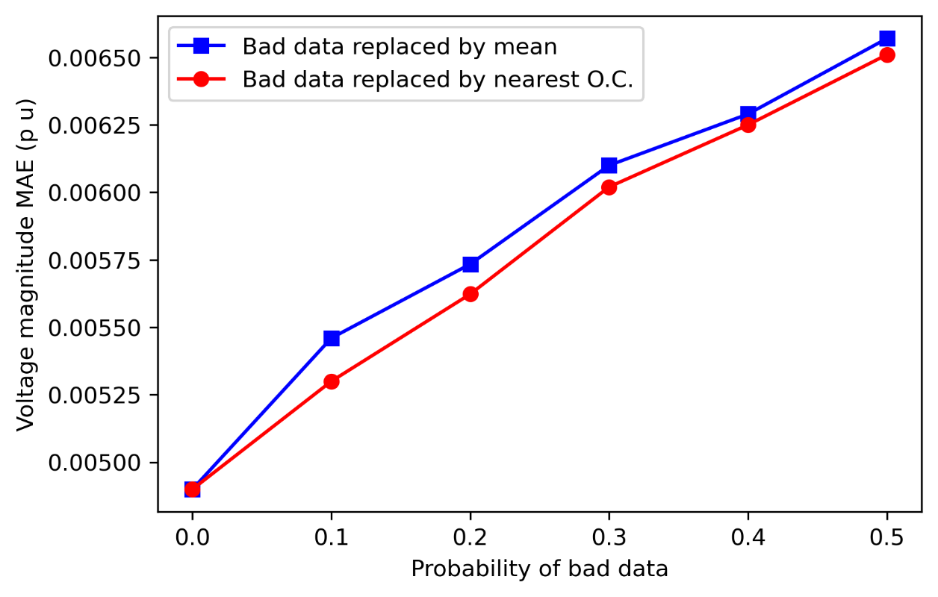
Improvement in Bad Data Replacement Method
Originally, the bad data was replaced using the mean value (in Task 3)
A better method is to replace the bad data with the data from the nearest OC calculated in the L₂ norm sense using the remaining good data

Slide 16
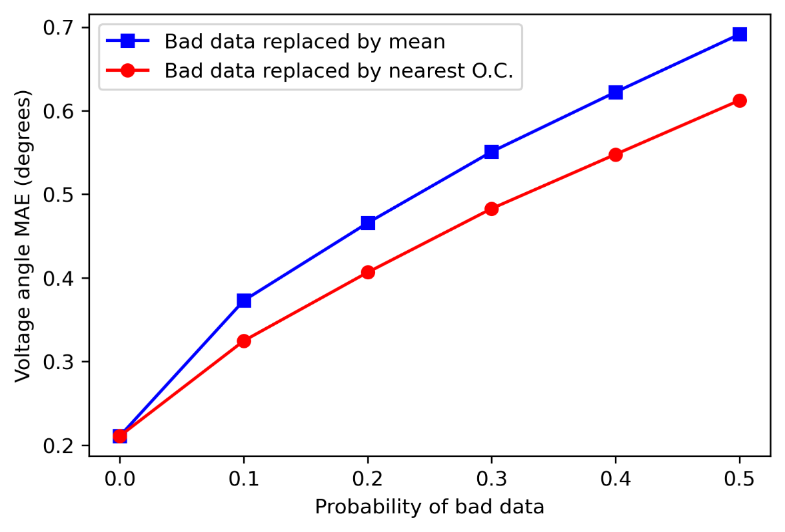
Improvement in Bad Data Replacement Method
More pronounced difference was observed in voltage phase angle (than voltage magnitude) by using the improved bad data replacement method

Slide 17
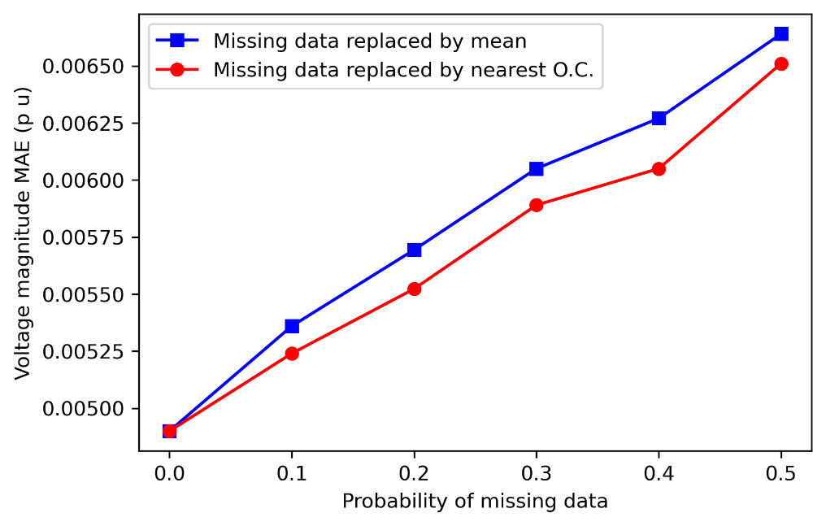
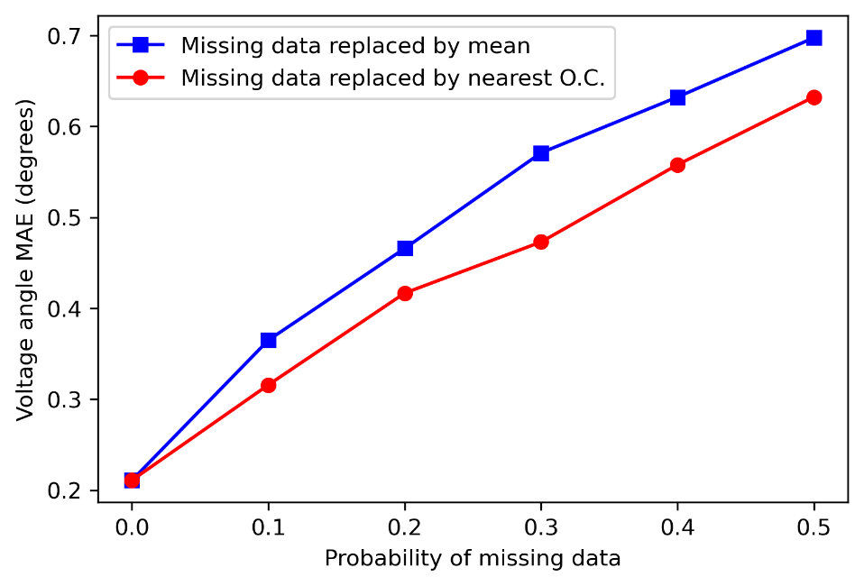
Missing Data Replacement
Similarly, in case of missing data also, the method of replacing using the data from nearest OC can be seen to be more advantageous than simply replacing it with mean of the same feature

Slide 18
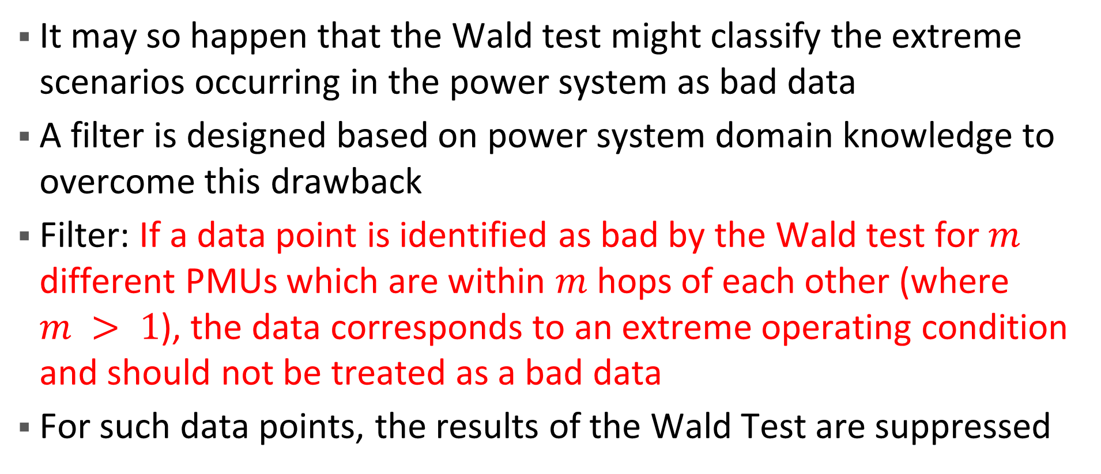
Extreme Scenario vs. Bad Data
It may so happen that the Wald test might classify the extreme scenarios occurring in the power system as bad data
A filter is designed based on power system domain knowledge to overcome this drawback
Filter: If a data point is identified as bad by the Wald test for $m$ different PMUs which are within $m$ hops of each other (where $m > 1$), the data corresponds to an extreme operating condition and should not be treated as a bad data
For such data points, the results of the Wald Test are suppressed

Slide 19
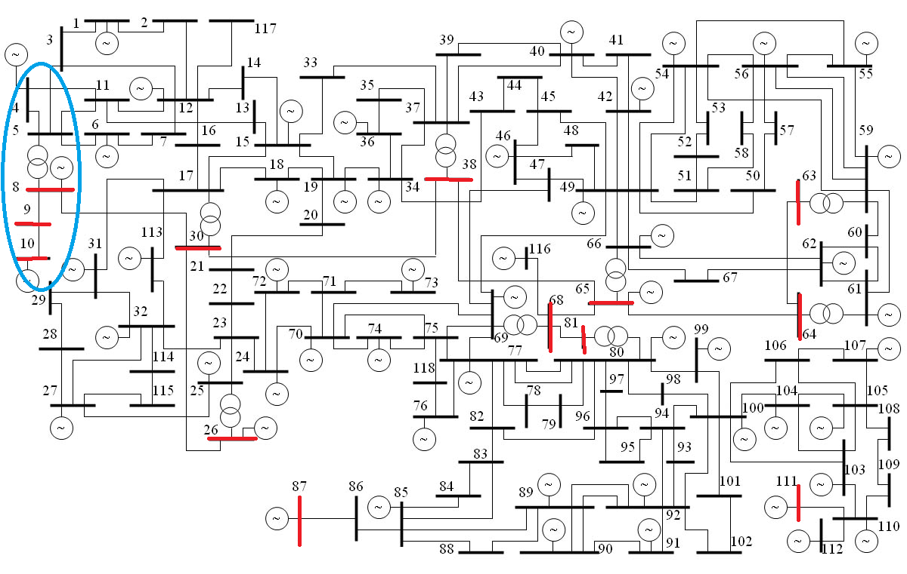
Extreme Scenario Generation - Example
Red color denotes the buses with PMU
An OC was identified such that the current and voltage variables in the Blue oval of the network have extreme values
For this OC, the line flows in branches 8-9 and 10-9 increased sharply

Slide 20
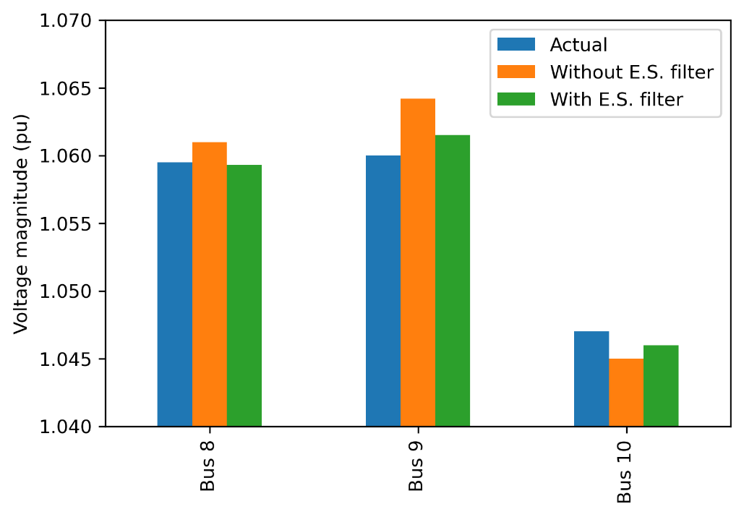
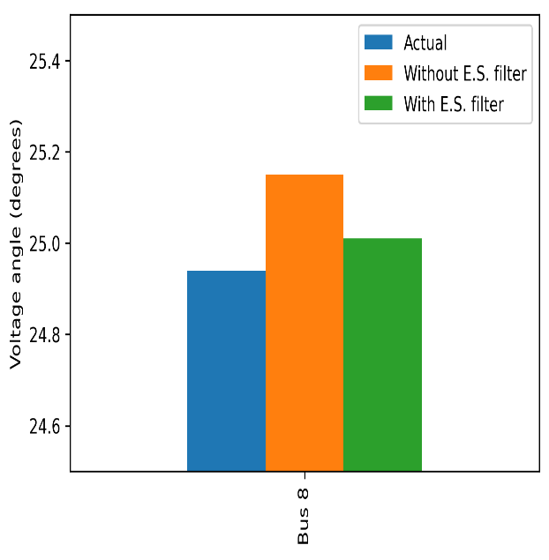
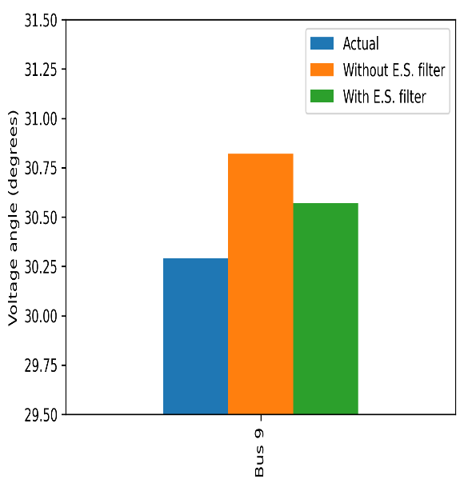
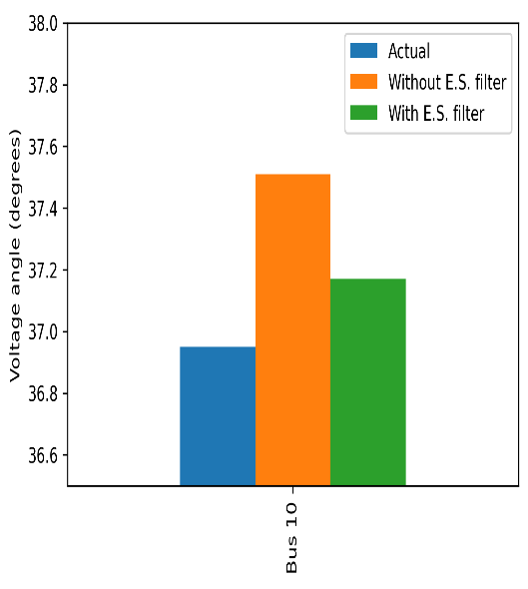
Extreme Scenario (ES) Detection Filter - Results
Variables detected to be crossing the Wald Test threshold in this case are:
Vm – Bus 9
Va – Bus 8, Bus 9
Im – Line 8-9, 9-10
Ia – Line 9-10
The proposed filter recognizes this as an extreme scenario
The results with and without use of this extreme scenario filter are displayed

Slide 21
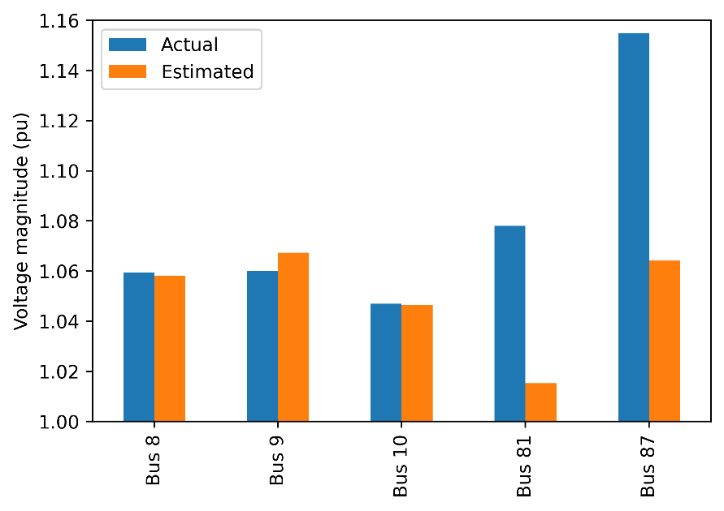
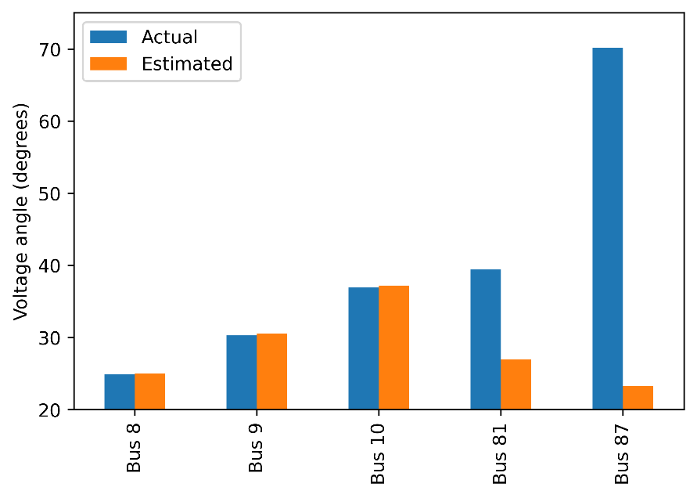
Differentiating Extreme Scenario From Bad Data
For the same extreme scenario discussed on the previous slide, bad data was added to the voltage magnitude and phase angle measurements of PMUs placed at buses 81 and 87
The ES filter identified these two data as bad data and replaced them
However, the measurements corresponding to the extreme scenario (i.e., the PMUs placed at buses 8, 9, and 10) were not altered

Slide 22
Task 6: Machine Learning Based State Estimation Software Development

Slide 23
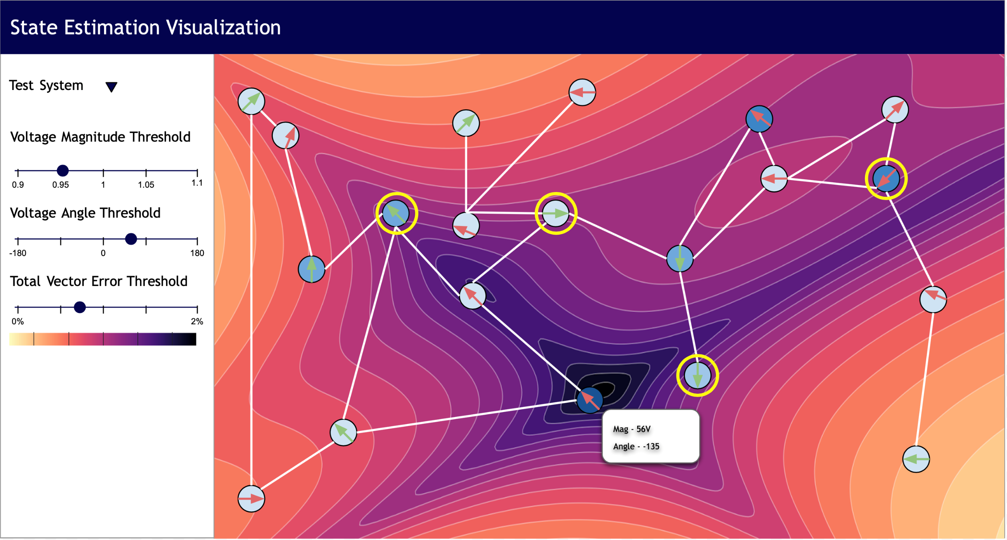
Draft Interface

Slide 24
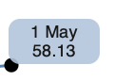
Possible Interactions
Filter bar - this will help users filter nodes of a certain voltage magnitude, error, and angle
Zooming and Panning - If number of nodes and edges increase, users can zoom to a certain region and pan across the graph
https://bl.ocks.org/EfratVil/92f894ac0ba265192411e73f633a3e2f
Lasso Selection - If number of nodes and edges increase, users can zoom to a certain region and pan across the graph
https://bl.ocks.org/skokenes/a85800be6d89c76c1ca98493ae777572
Tooltips - This will help users to get more information about the hovered node

Slide 25
Conclusion & Upcoming Tasks
A better method to replace bad data was identified and implemented
An intelligent alarming technique to differentiate between bad data and extreme scenarios was developed
Next Tasks:
Detecting events/network parameters (breaker opening, tracking line impedances)
Implementing the presented interface

Slide 26
Q&A Thank You For Your Time

